Slide 1
Tracks and Transfers, Statistics and Strategies
University Of Denver Writing Program
Symposium on Futures Of College Writing
June 15, 2017
Jennifer Campbell, April Chapman-Ludwig,
Rob Gilmor, and Zoe Tobier

Slide 2
Agenda
Preliminary Results from Off-Track Study
Jennifer Campbell
Teaching Transfer Students to Navigate the Writing Sequence
April Chapman-Ludwig
Into the Archives
Rob Gilmor
Writing Transfer Students’ Stories of Self, Other, and Community
Zoe Tobier

Slide 3
Off-Track Study
Context
Methods
Course Evaluation Comparison
Off-Track Portfolio Scoring
Exit Surveys
Student Focus Groups
Faculty Interviews

Slide 4
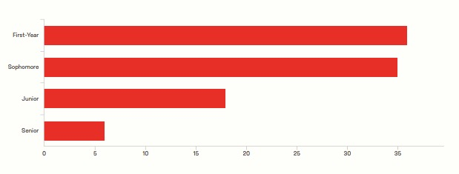
Who’s taking 1133 off-track & Why?
About 70% did not take WRIT 1122 at DU.
About 82% of those earned credit through AP/IB or dual enrollment.
Scheduling and “getting it out of the way” are most common reasons.
Class standing of off-track students
Notes:
Twenty-two transfer students responded. They mentioned that professors should keep their varied backgrounds in mind—while some have “zero research experience,” they do have interesting personal and academic experiences.. Students like when they can draw on those. Be careful about “tossing around terms like ‘FSEM’ and other ‘on track’ tools that transfer students didn't/couldn't attend and have no idea what they are.” Other students felt they knew a lot already, so we need to be ready to challenge them.
WHY?
Three were waiting for a specific professor and one mentioned the course topic. There were a couple of previous drops and a medical leave. Three mentioned that they wanted to improve their writing skills as soon as possible to help in other class. The VAST majority, however, wanted to “get it out of the way” when it fit their schedule.

Slide 5
What do they think of their classes?
Course Evaluations
I compared course evaluations for the same group of instructors who taught on-and off-track classes from 2012-2015. I emphasized five criteria. You can see in Table 1 that means for all categories were slightly lower for off-track classes, with the most notable difference on interest in taking the class.
Comparison of on- and off-track course evaluations on five criteria

Slide 6
What do they think of their classes?
Focus Groups – General Impressions
We conducted four focus groups with a total of 13 students
Our classes aren’t nearly as important to our students as we’d like them to be
Students generally do learn in these classes, but there were concerns at the extremes of ability
Some concerns about consistency across sections
Many off-track students don’t feel like part of a class community
We need better advising and transfer student programming more generally
Transfer students would like more options—perhaps a choice to take an advanced or minor course if they have previous research writing experience

Slide 7
How Do Off-Track Students Perform?

Slide 8
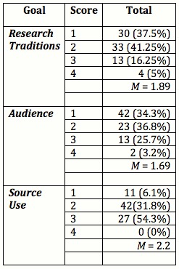
Portfolio Goal Scores
Off-Track 2015-2016
On-Track 2016

Slide 9
“Lost In the Tulgey Wood”
Teaching Transfer Students to Navigate the Writing Sequence

Slide 10
What is the transfer student experience like at this university?
Why don’t my classes transfer? Why do I have to take this “freshman writing class” again?
I feel like the red-headed stepchild of the university. No one really cares about the transfer student…all of the focus is on the freshman student.
I don’t know how to work with younger students. Their priorities are not the same.
Should I tell my professor I’m older? Do they care?

Slide 11
If you came to DU as a transfer student, describe the last college you attended. Describe what you have in common with your fellow students at DU. Describe how you are different.
My previous university was too grandiose and impersonal.
I felt lost in the crowd.
I was looking for a tighter community.
I found open-minded outdoor enthusiasts.
I found my niche with the Asian Student Alliance.
DU students are “rich, privileged, preppy”; “lack culture”; and “don’t have adult responsibilities.”

Slide 12
Connecting to Communities
List student groups. Circle communities they are a part of. Brainstorm subcultures.

Slide 13
How do faculty and staff understand or foster the student veteran transition to the university? Are faculty/staff trained by the university? Do they know about potential veteran services?
Guiding Questions

